Slide 1


Minor Project Title: Rail Metro App Using Dijkstra’s And ACO Algorithm
Presented by:
Hitendra Sisodia
Ujesh Sisodia
Arnav Sharma
Kartikay Kanojia
Guided by:
Dr Keshav Sinna
Assistant Professor
School of Computer Science

Slide 2
Rail Metro Using Dijkstra Algorithm And ACO
Data Structures
Unordered Map
Priority Queue
Dynamic Array (vector)
Graph 📊

Slide 3
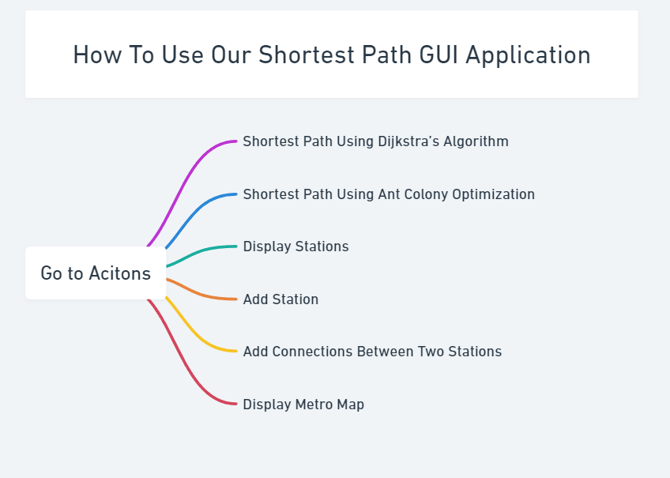

Slide 4
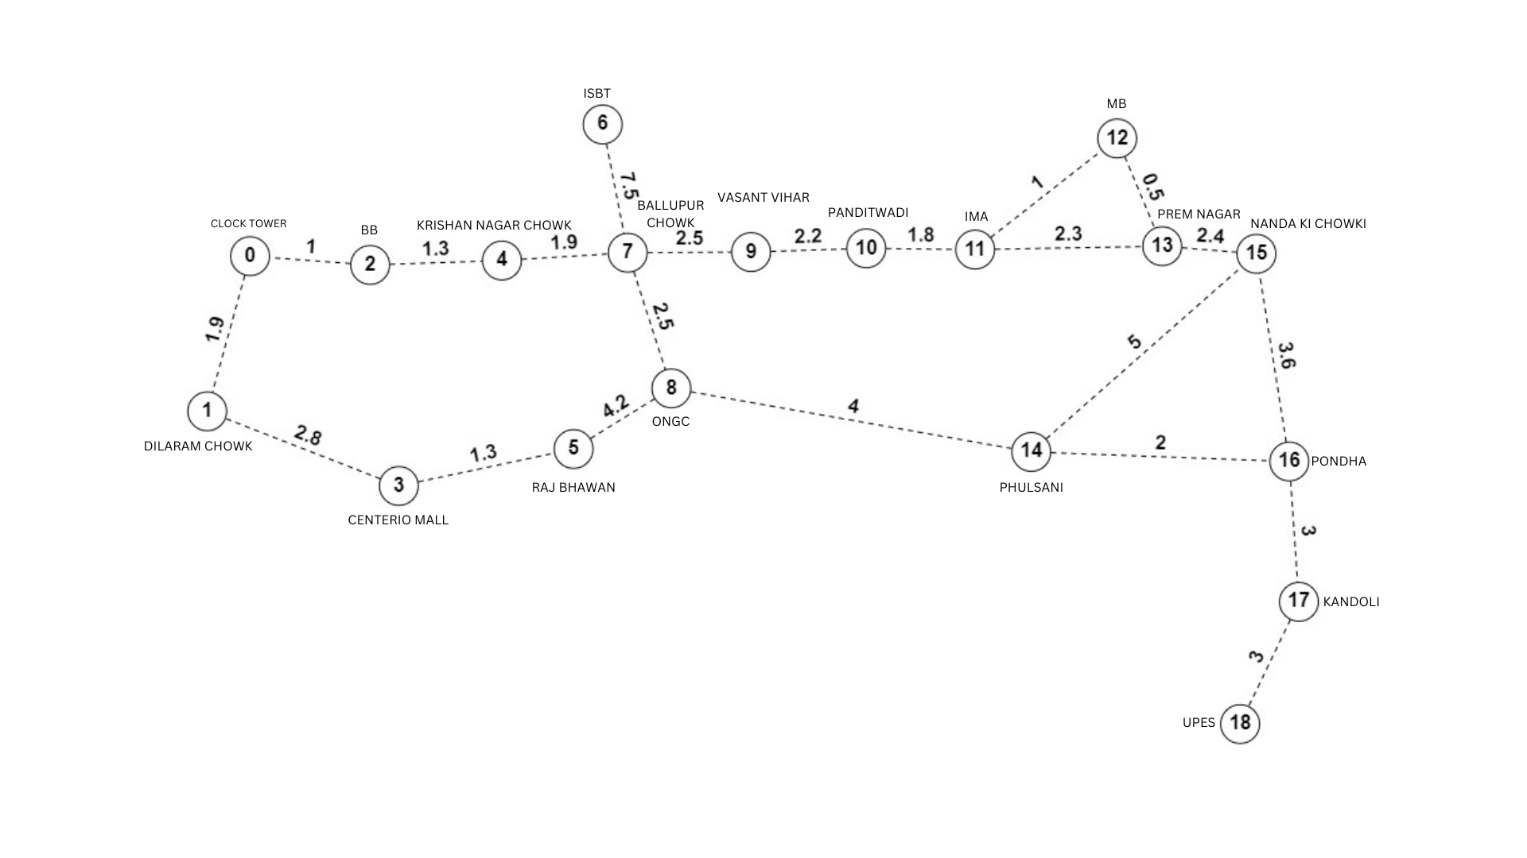

Slide 5
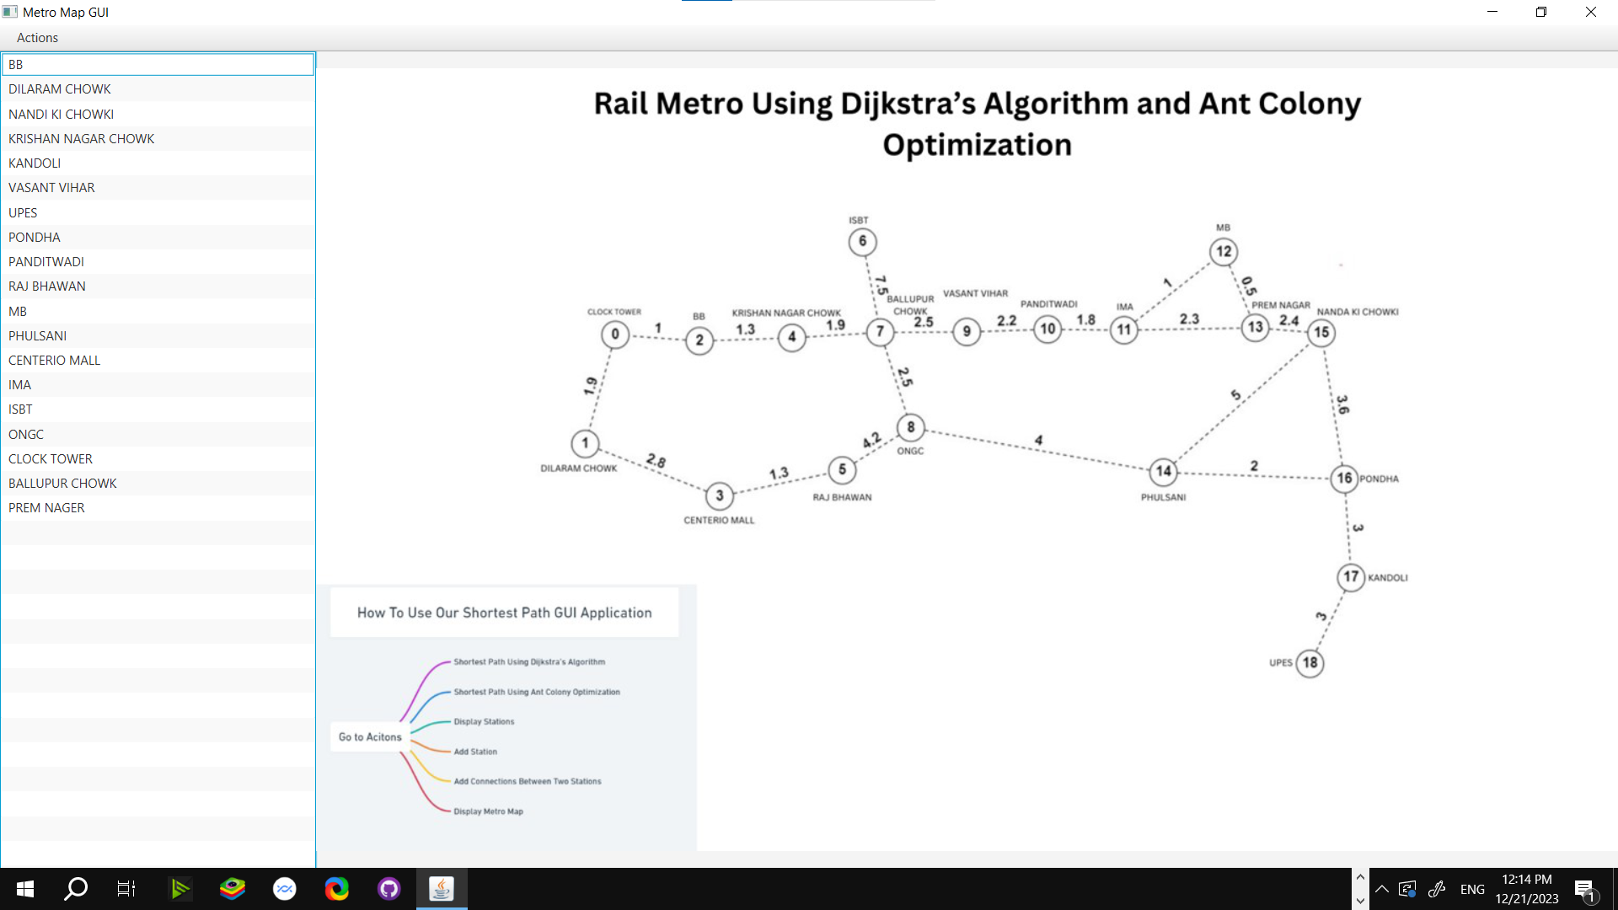

Slide 6
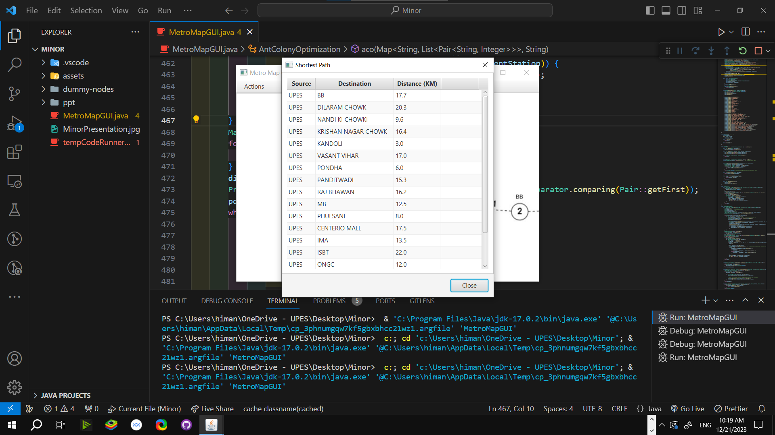

Slide 7
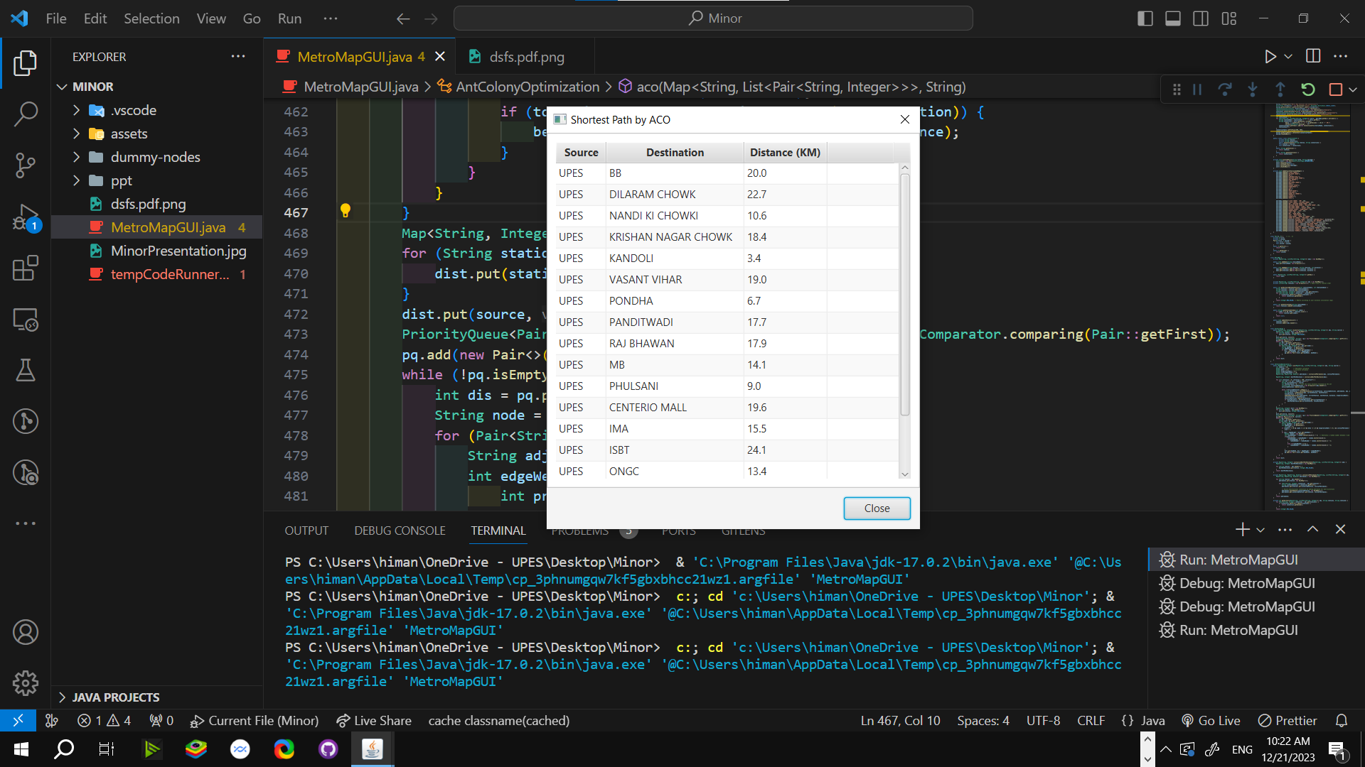

Slide 8
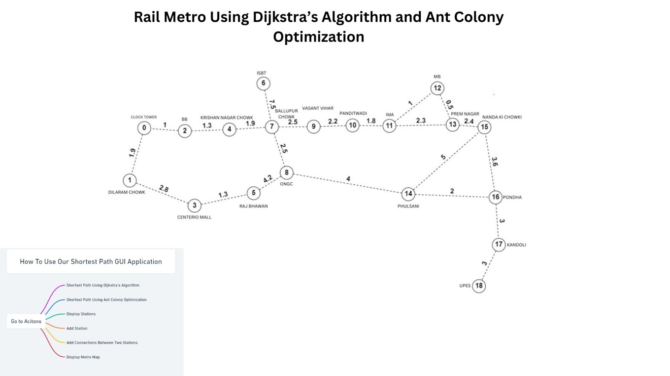

Slide 9
